Slide 1

Decision-Making Under Pressure
OODA Loop + Red Teaming
How pressure disrupts thinking clarity
OODA Loop decision structure explained
Red Teaming as cognitive correction
Applying disciplined judgment under stress

Slide 2
CLASS AGENDA
CLASS OBJECTIVES
How pressure disrupts thinking clarity
OODA Loop decision structure explained
Where decisions fail during compression
Red Teaming as cognitive correction
Applying disciplined judgment under stress
Understand how crisis alters cognition
Restore structure when instinct dominates
Recognize breakdowns during execution
Use Red Teaming to prevent blind spots
Protect decision quality under urgency

Slide 3

Why Pressure Distorts Decision Logic
Pressure accelerates threat perception before reasoning stabilizes
Emotional intensity overwhelms analytical thinking capacity quickly
Uncertainty triggers survival-mode mental shortcuts automatically
People react faster than they orient when stress dominates

Slide 4

Cognition Under Threat
The brain defaults to instinctive processing over reflective reasoning
Perception narrows as emotional urgency replaces evaluation
Accuracy declines when meaning is rushed through bias
Orientation collapses when fight-flight overrides context

Slide 5
Decision Impairment Pivot
Shortened analysis reduces interpretive accuracy
Loss of nuance drives rigid interpretation
Threat bias exaggerates minor signals instantly
Narrow lens discards critical situational inputs
Misread cues distort the initial observational frame
Habit-driven action replaces adaptive reasoning
Emotional jumps replace calm sequencing logic
Reactive posture signals cognitive instability
Premature closure skips needed validation steps
Confidence collapse weakens executive clarity

Slide 6
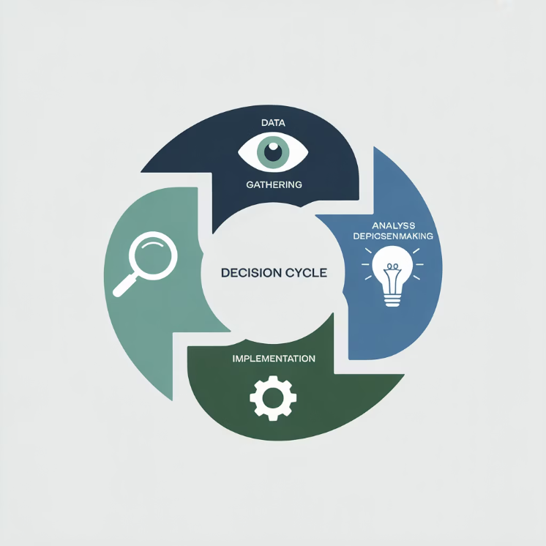
OODA Loop Overview
Observe→Orient→Decide→Act structures thought under pressure
OODA shortens reaction time without losing coherence
It restores rhythm when situations destabilize cognition
Leaders cycle clarity faster than they escalate urgency

Slide 7

Observe Phase
Observing requires noticing reality before conclusions form
Early signals shape every subsequent decision window
Attention determines what becomes cognitively "true"
Perception quality defines downstream correctness

Slide 8

Orient Phase
Orientation is where the mind makes meaning from signals
Bias enters here before decisions consciously register
Interpretation outruns data when stress accelerates tempo
Poor orientation corrupts every later action choice

Slide 9

Decide + Act
Decisions must be short, directional, and psychologically stabilizing
Action resets the loop and reopens awareness possibilities
Iteration outperforms hesitation when time is compressed
The goal is feedback-driven clarity, not perfection

Slide 10
Where OODA Fails
Observation narrows too early under pressure
Bias overwhelms neutral interpretation rapidly
Orientation rushes before context stabilizes
Assumptions masquerade as verified inputs
Decision guesses become unchallenged assumptions
Emotional leakage warps perceived urgency
Action detaches from updated ground reality
Overconfidence masks missing evidence
Tempo becomes speed without coherence
The loop is never consciously refreshed

Slide 11

Why Red Teaming Exists
Red Teaming injects structured skepticism into decisions
It builds cognitive friction before failure compounds
Assumptions are stress-tested before commitment forms
It improves orientation quality before acting

Slide 12

Red Teaming as Stabilizer
It restores doubt where certainty is undeserved
It surfaces blind spots leaders can't self-see under load
It protects reasoning before escalation snowballs risk
It enables correction without reputational friction

Slide 13

Reducing Cognitive Blind Spots
Hidden risk surfaces when interpretation is challenged deliberately
Perspective expands before commitment narrows judgment
Decisions land on stronger orientation, not speed alone
Challenge input strengthens outcome legitimacy

Slide 14

Psychological Benefit of Challenge
External challenge stabilizes overconfident reasoning patterns
Leaders gain cognitive distance from their assumptions
Fear-based urgency transitions into grounded clarity
Pressure no longer dictates interpretive framing

Slide 15
Red Teaming Value Pivot
Better framing improves psychological precision
Fewer blind spots surface in execution
Stronger orientation protects decision accuracy
More robust choices remain available longer
Safer reasoning resists emotional distortion
Shared accountability prevents dominance errors
Reduced bias stabilizes confidence internally
Trust deepens when challenge is normalized
Higher clarity lowers escalation risk
Faster iteration emerges from cognitive safety

Slide 16

Tempo Discipline
Tempo is psychological leadership, not operational speed
Direction loses value if delivered at the wrong pacing
Leaders must decelerate thinking to preserve cognition
Controlled tempo widens reasoning bandwidth

Slide 17

Signal vs Noise
Filtering protects attention from destabilizing distractions
Not every signal deserves identical cognitive weight
Noise appears urgent but rarely informs judgment
Leaders protect focus to preserve accuracy

Slide 18

Command vs Challenge
Command provides direction when clarity collapses
Challenge protects reasoning from internal distortion
Both are needed to safeguard psychological accuracy
Balance defines decision maturity under pressure

Slide 19
Decision Discipline Pivot
Deliberate framing slows reaction instinct
Intentional observation improves orientation
Defined posture prevents emotional takeover
Calm interpretation lowers bias distortion
No panic pacing preserves reasoning bandwidth
Bounded choices prevent decision sprawl
Short cycles reduce uncertainty fatigue
Visible ownership stabilizes team confidence
Continuous reset conditions cognitive stability
Controlled tempo keeps judgment coherent

Slide 20

Integrating OODA + Red Teaming
OODA restores cognitive rhythm during instability
Red Teaming protects interpretation before action
Together they produce durable decision accuracy
Integration creates repeatable judgment discipline

Slide 21

Summary and Key Takeaways
Crisis pressure degrades cognition before leaders notice
OODA restores psychological rhythm and mental footing
Red Teaming prevents silent interpretation failures early
Decision quality depends on protected orientation first
Tempo must be controlled to maintain clarity under load
Challenge improves confidence by stabilizing reasoning
Disciplined thinking becomes a leadership capability

Slide 22
BREAK TIME
Be back in 15 mins.
Notes:
https://www.ncsc.gov.uk/static-assets/documents/PwnedPasswordsTop100k.txt

Slide 23

Leader Visibility, Empathy, and Communication
Stability, legitimacy, and psychological containment
This session explores how visibility, empathy, and communication function as psychological stabilization tools for crisis leadership, providing essential insights for maintaining team cohesion and organizational resilience during periods of uncertainty.
Why visibility matters under pressure
How empathy stabilizes emotional tone
Communication as psychological containment
Applying presence as an active skill

Slide 24
CLASS AGENDA
CLASS OBJECTIVES
Why visibility matters under pressure
How empathy stabilizes emotional tone
Communication as psychological containment
Trait interplay during escalation moments
Applying presence as an active skill
Understand visibility as psychological signaling
See empathy as a stabilizing leadership force
Use communication to regulate uncertainty
Translate posture into perceived safety
Build credibility through consistent presence

Slide 25
Why These Traits Shape Crisis Outcomes
People anchor emotional safety to visible leadership presence
Uncertainty lowers trust unless empathy moderates fear
Communication defines perceived control before outcomes do
The leader becomes the nervous system of the group

Slide 26

Visibility in Crisis Leadership
Visibility signals continued control when stability feels uncertain
Leaders become reassurance by simply being observable consistently
Hidden leadership fosters anxiety and threat imagination
Perceived presence reduces cognitive panic without instruction

Slide 27
VISIBILITY REFLECTION
Presence outperforms explanation in early crisis stage
Withdrawal amplifies doubt and threat perception
People watch posture before hearing content
Physical absence invites imagined escalation
Visible leadership shrinks uncertainty automatically
Interpretation fills vacuum faster than facts
Eye contact signals stability and containment
People follow the most visible anchor
Silence feels safe only when presence is active
Trust strengthens when leaders stay accessible

Slide 28

Empathy in Crisis Leadership
Empathy regulates emotional intensity before logic returns
People need to feel understood before they can re-engage cognitively
Containment is psychological before operational
Acknowledgment restores psychological footing without fixing events

Slide 29
EMPATHY REFLECTION
Empathy lowers limbic threat activation rapidly
Dismissal triggers defensive withdrawal instantly
People relax when their fear is recognized
Surface reassurance feels emotionally hollow
Listening communicates safety more than instruction
Tone communicates care faster than words
Emotional validation precedes cognitive clarity
Real empathy prevents perceived abandonment
Calm recognition slows panic escalation
Psychological safety precedes regained reasoning

Slide 30

Communication as Psychological Containment
Communication is not information delivery but emotional stabilization
People need pacing, not volume, when fear rises
Message tone anchors meaning before content matters
Consistency becomes proof of control under threat

Slide 31
COMMUNICATION REFLECTION
Slow cadence lowers nervous system intensity
Over-talking signals leader insecurity
Repetition signals reliability and grounding
Mixed phrasing fractures trust signals quickly
Simplicity helps cognition re-open under stress
Emotion travels faster than directives
Calm tone substitutes for missing certainty
Silence without presence feels abandonment
Clarity restores inward stability gradually
Stabilizing language must outpace uncertainty

Slide 32

Connecting Visibility, Empathy, and Communication
These traits reinforce one another as a containment system
Visibility projects safety, empathy absorbs fear, communication stabilizes mindstate
Together they form psychological infrastructure, not charisma
Leadership posture precedes leadership content every time

Slide 33
INTEGRATION REFLECTION
People follow emotional anchors before instruction
Visibility earns permission to influence
Presence signals safety before logic reaches cognition
Empathy keeps trust stable under threat
Tone regulates nervous system interpretation
Communication maintains orientation recovery
Psychological cues matter more than structure
Posture becomes credibility evidence
Containment is leadership's first job
Calm behavior becomes leadership proof

Slide 34

SUMMARY & TAKEAWAYS
Visibility counters fear by signaling stable leadership
Empathy reopens cognition by lowering emotional threat
Communication regulates psychological state before content lands
Tone and presence shape perceived safety more than messaging
Containment is delivered through posture, not authority
Credibility is earned emotionally before operationally
These traits are crisis stabilization tools, not soft skills

Slide 35
BREAK TIME
Be back in 15 mins.
Notes:
https://www.ncsc.gov.uk/static-assets/documents/PwnedPasswordsTop100k.txt

Slide 36

Integrating Cyber, Business & Operational Resilience Across Silos
Unified governance across interdependent domains
Why organizational silos fail during crisis
Domain-specific integration perspectives
Unified governance fundamentals
Achieving integration maturity

Slide 37
CLASS AGENDA
CLASS OBJECTIVES
Why silos fail during crisis
Cyber as peer capability
Business alignment as direction
Operations as execution layer
Converging into unified governance
Understand cross-domain alignment
See how governance creates cohesion
Clarify roles across integration
Prevent disconnects in escalation
Move from parallel to unified response

Slide 38

What Integration Actually Means
Integration links domains into one governed capability
It eliminates competing interpretations under pressure
Alignment matters more than documentation volume
Coherence replaces coexistence when maturity rises

Slide 39

Why Silos Break Under Stress
Each domain defaults to its own urgency first
Misaligned timing fractures shared direction
Lack of clarity slows escalation confidence
Fragmentation becomes visible immediately in crisis

Slide 40
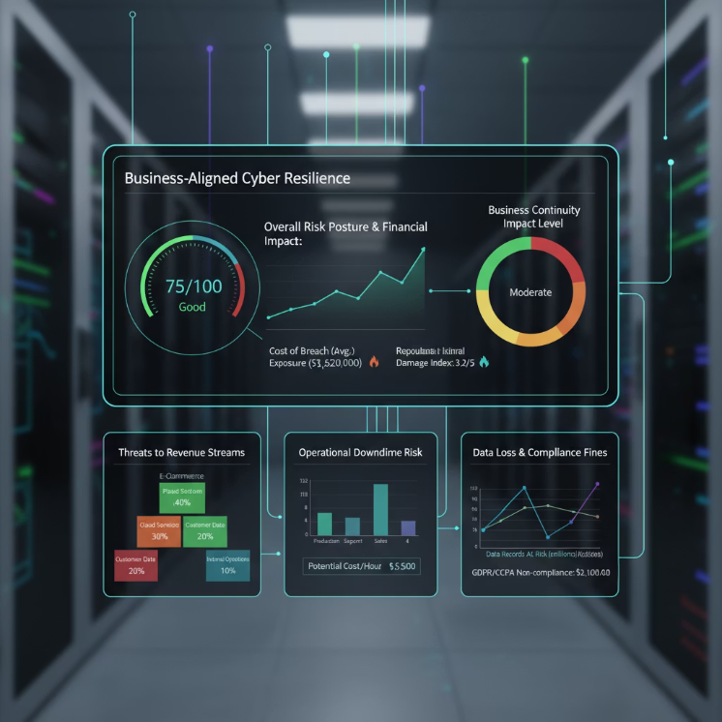
Cyber Integration Perspective
Cyber informs continuity through consequence context
Influence comes from alignment, not technical depth
Risk translation matters more than raw detection
Maturity shows when signals connect to impact

Slide 41
PIVOT #1 – Cyber Integration Reflection
Cyber must connect to business meaning
Cyber is a peer resilience domain
Visibility is useless without shared context
Authority comes from relevance, not scope
Impact defines urgency, not alerts
Value is measured through consequence
Integration is translation, not tooling
Ownership aligns through framing
Governance requires consequence clarity
Integration is how signals gain trust

Slide 42
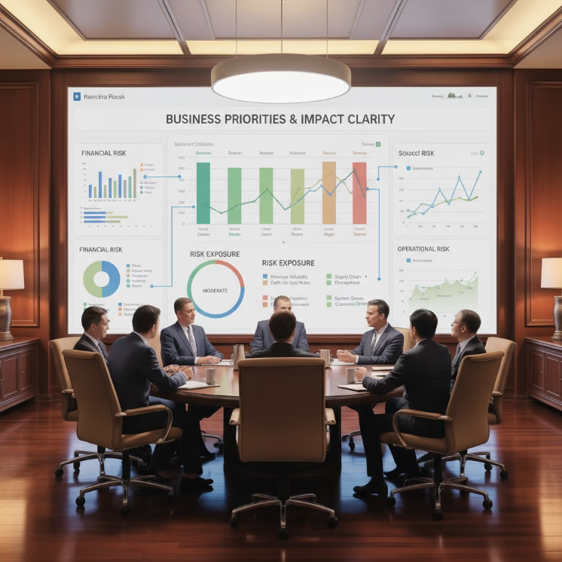
Business Integration Perspective
Business defines which risks matter most
Consequence drives legitimacy in escalation
Other domains integrate to this anchor point
Priority is established through impact clarity

Slide 43
PIVOT #2 – Business Reflection
Business sets direction through consequence
Governance starts with purpose
Meaning precedes control in escalation
Ownership follows consequence alignment
Integration needs an anchor, not a silo
Risk gains context before action
Priority clarity stabilizes decision flow
Authority is anchored by impact
Legitimacy comes from impact framing
Business centers the why of response

Slide 44

Operational Integration Perspective
Operations convert plans into continuity reality
Feasibility defines maturity during activation
Timing must reflect actual interdependencies
Ops proof-tests integration in execution

Slide 45
PIVOT #3 – Ops Reflection
Execution reveals true maturity levels
No domain fixes misalignment in motion
Plans break when timing is unclear
Pre-work decides execution success
Feasibility exposes governance quality
Handoffs require governed pathways
Ops inherits upstream clarity or drift
Silence cannot replace clarity
Integration succeeds when handoffs hold
Ops makes alignment visible

Slide 46

Where Alignment Fails
Domains assume leadership instead of parity
Signals lose meaning when context diverges
Governance breaks when urgency is contested
Misalignment is structural, not personal

Slide 47

Governance Alignment Fundamentals
Integration is owned through escalation logic
Alignment is proven before activation triggers
Governance clarifies "who owns the call"
Certainty reduces hesitation in fast tempo

Slide 48
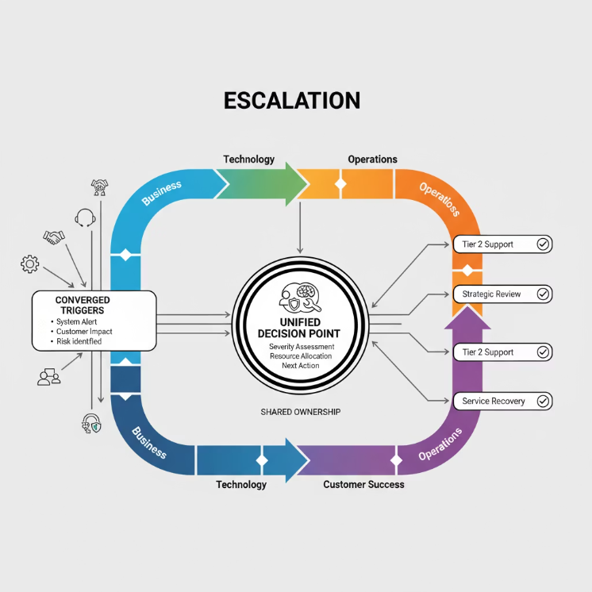
Unified Escalation Pathways
Converged triggers protect timing discipline
Shared ownership removes negotiation friction
Escalation is faster when uncontested
Alignment creates trust before action

Slide 49
PIVOT #4 – Alignment Reflection
Integration is timing + ownership
Fragmentation is a governance gap
Escalation must feel uncontested
Alignment removes decision friction
Authority stabilizes shared posture
Timelines unify consequence urgency
Trust grows from aligned signals
Clear triggers protect execution
Structure prevents drift in action
Maturity shows in seamlessness

Slide 50

Integrated Operating Model
Domains function as one decision system
Ownership becomes shared, not competing
Structure creates confidence under stress
Integration replaces interpretation risk

Slide 51
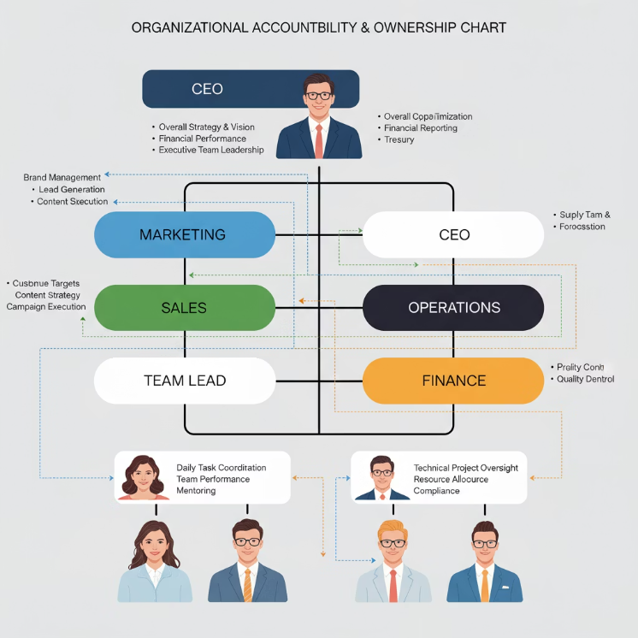
Role & Ownership Mapping
Accountability must be explicit, not implied
Mapping prevents jurisdiction confusion
Ownership stabilizes momentum
Clarity removes hesitation loops

Slide 52
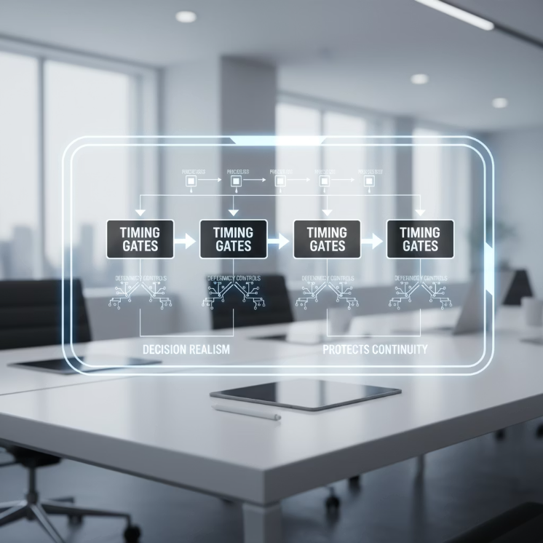
Sequencing & Dependency Control
Recovery depends on governed order, not speed
Interlocks must be defined before activation
Dependencies anchor decision realism
Timing discipline protects continuity

Slide 53
PIVOT #5 – Integration Synthesis
Cyber informs, business frames, ops delivers
Maturity is timing + meaning
Integration makes alignment predictable
Coordination is downstream of structure
Trust rises when posture is unified
Domains become complementary, not rival
Shared triggers replace negotiation
Ownership becomes collective confidence
Governance is coherence under pressure
Integration feels seamless when real

Slide 54

Integration Maturity Signals
Teams move as one unit under stress
No domain competes for control
Escalation feels natural, not forced
Trust remains stable during uncertainty

Slide 55

What Real Integration Looks Like
Alignment removes friction in fast tempo
Context stays consistent across domains
Ownership never needs explanation
Structure becomes felt, not spoken

Slide 56

SUMMARY & TAKEAWAYS
Integration is governance maturity, not cooperation
Cyber is a peer domain aligned to consequence
Business frames priority through impact
Operations convert strategy into continuity
Shared triggers stabilize escalation trust
Parity protects legitimacy in crisis
Real integration is the absence of negotiation

Slide 57
BREAK TIME
Be back in 15 mins.
Notes:
https://www.ncsc.gov.uk/static-assets/documents/PwnedPasswordsTop100k.txt

Slide 58
Lab Time
1 Hour
Notes:
https://www.ncsc.gov.uk/static-assets/documents/PwnedPasswordsTop100k.txt

Slide 59


Decision-Making Under Pressure (OODA + Red Teaming)
Pressure collapses reasoning before leaders notice
OODA restores clarity and thinking rhythm
Red Teaming protects orientation from bias
Discipline matters more than speed
Challenge improves decision legitimacy
Governance Anchor: "Decision quality is a governance outcome, not a personal intuition."

Slide 60

Integrating Cyber, Business & Operational Resilience
Integration = one governed capability, not cooperation
Business frames meaning and consequence
Cyber informs impact through relevance
Operations convert strategy into continuity
Alignment removes negotiation friction
Governance Anchor: "Integration proves governance maturity when ownership is uncontested."

Slide 61

Cross-Domain Decision Alignment
Domains fail when timing is not unified
Shared triggers stabilize escalation posture
Parity protects legitimacy across response teams
Integration replaces interpretation risk
Clarity protects tempo under pressure
Governance Anchor: "Where alignment exists, crisis posture becomes predictable and trusted."

Slide 62

Workshop: Crisis Communication Strategy
Communication restores psychological safety during uncertainty
Narrative discipline prevents external drift
Tone signals control faster than detail
Stakeholder trust is a resilience metric
Strategy = emotional containment before messaging
Governance Anchor: "Crisis communication is governance in public form."

Slide 63
Kahootz & Quiz Time
Notes:
https://www.ncsc.gov.uk/static-assets/documents/PwnedPasswordsTop100k.txt

